Slide 1
Discussion 13: A* Search and MST’s
Christine Zhou

Slide 2
Agenda
Announcements
Review: Dijkstra’s and A* Search
Problem 1
Review: MST’s
Problem 2

Slide 3
Announcements
HW7 due today!
Even if you can’t push, remember to commit your work
Proj3: Gitlet is out!
Due 12/6, Wednesday of dead week
Last discussion and lab is next week! :O
Tentative dead week schedule:
No discussion section
Lab sections
Final review (no project questions)
Each lab will be focused on a particular topic
OH
Project questions
No extra OH

Slide 4
Dijkstra’s Algorithm
Any lingering questions about Dijkstra’s algorithm?
What if we only wanted to find a path from SF to NYC? Would Dijkstra’s work?
Yes, but we can do better...

Slide 5
A* Search
Useful when we have a single target in mind, we only search in a direction that brings us closer to our goal
Introduce heuristics: an estimate from any vertex to the goal vertex
These values will be provided for you by someone/something
Do the same procedure as Dijkstra’s, except add “distTo(v) + h(v)” to the fringe instead of “distTo(v)”
Fringe will contain total distances from the start to the end
Explore the path to the goal that is the smallest, according to our heuristic
Keep exploring until we have popped off the goal

Slide 6
Heuristics
Admissible: heuristic cannot overestimate distance from the current vertex to the goal
Consistent: change in heuristic between v and w cannot exceed actual change in distance between v and w

Slide 7
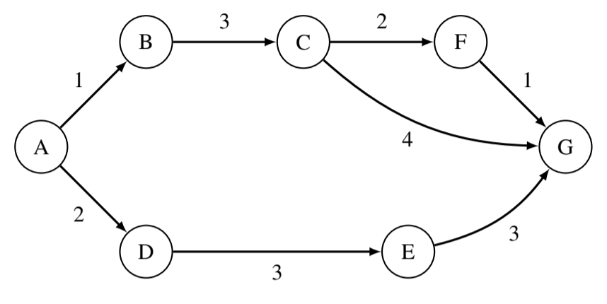
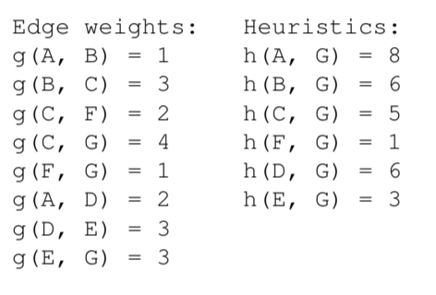
1 A* Search
Given the weights and heuristic values for the graph below, what path would A* search return, starting from A and with G as a goal?
Is the heuristic admissible? Why or why not?

Slide 8
Minimum Spanning Trees
Tree: must have V-1 edges, no cycles
Spanning: the set of edges must connect all vertices
Minimum: the spanning tree must have the smallest total weight
MST: a tree that connects all vertices with the smallest total weight

Slide 9
Prim’s Algorithm
Pick an arbitrary starting point
Always pick the minimum edge that is connected to the graph you are building up that connects to a vertex not already in the graph

Slide 10
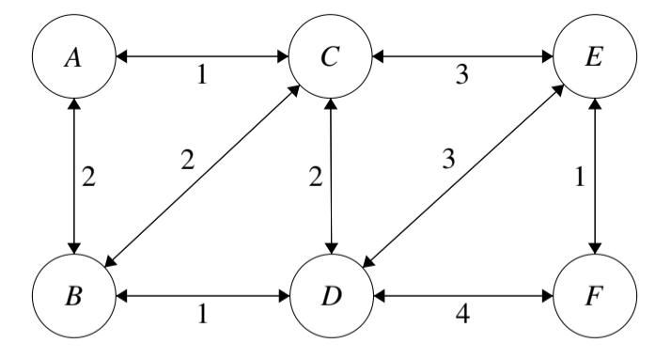
2 Minimum Spanning Trees
Perform Prim’s algorithm to find the minimum spanning tree of the above graph. Pick A as the initial node. Whenever there are more than one node with the same cost, process them in alphabetical order. (BE comes before CE)

Slide 11
Kruskal’s Algorithm
Always pick the minimum edge (unless it creates a cycle)
How do we check cycles?

Slide 12
Weighted Quick Union with Path Compression
Used to represent connectivity between items
Each item belongs to its own set, “union” the items together by connecting the sets together
Sets will have a tree like structure
Optimizations:
Union by weight: connect the root of the “lighter” set to the root of the “heavier” set (determined by number of nodes in the set)
Path compression: when you “find” a node, compress the node and the path to the node by connecting it to the root of the set
61BL Lab about Disjoint Sets

Slide 13
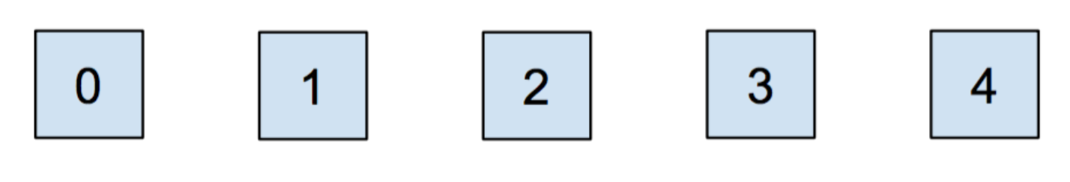
WQUF w/ PC
Let’s union(0, 1) and union(2, 3)!

Slide 14
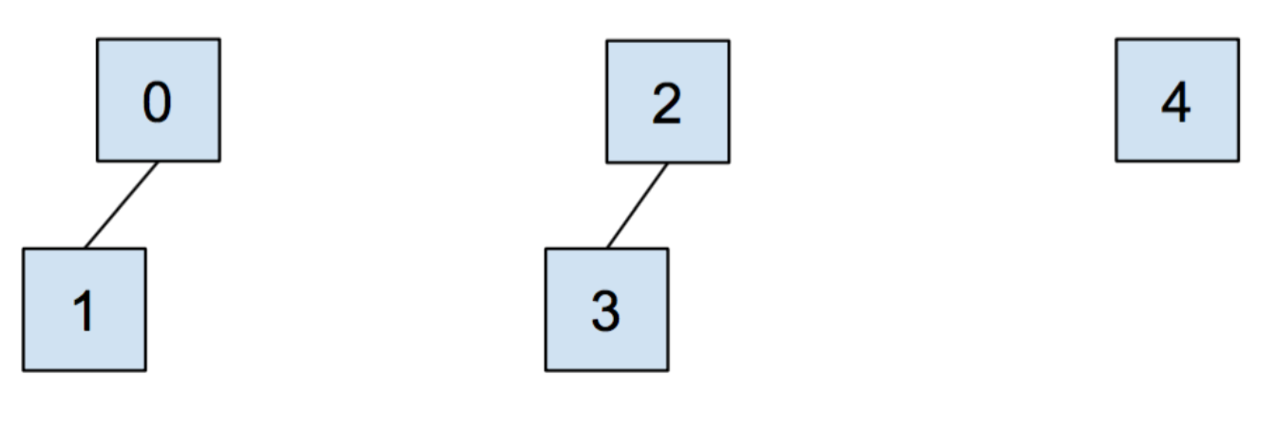
Now let’s union (1, 3)!

Slide 15
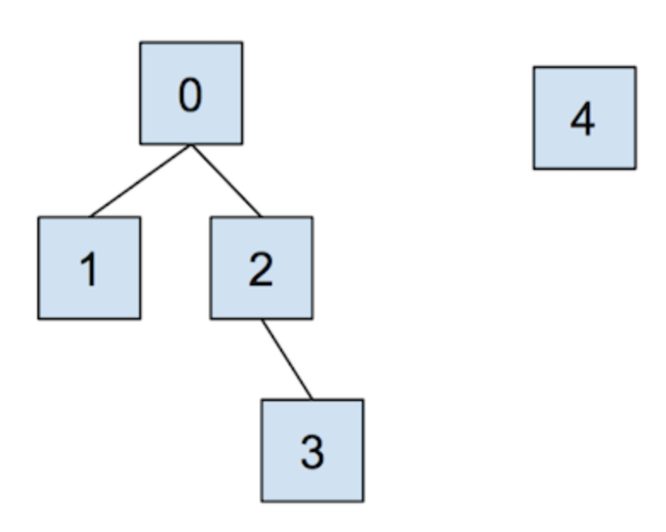
What would happen if we did “find(3)”?

Slide 16
2 Minimum Spanning Trees
b) Use Kruskal’s algorithm to find a minimum spanning tree. Is it the same as the one found by Prim’s?
c) Draw the resulting WQU tree at the end of the execution of Kruskal’s. When there are ties, choose the root to be the alphabetically first node. (There may be multiple possible answers)

